Slide 1


Slide 2
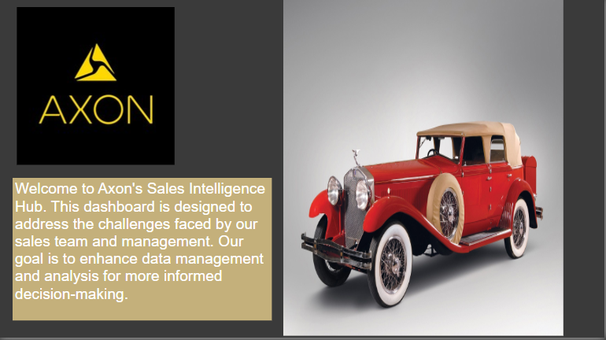
INTRODUCTION

Slide 3
Schema’s
The MySQL sample database schema consists of the following 8 tables:
Customers:
Stores customer’s data.
Products:
Stores a list of scale model cars.
Product Lines:
Stores a list of product line categories.
Orders:
Stores sales orders placed by customers.

Slide 4
Schema’s
Order Details:
Stores sales order line items for each sales order.
Payments:
stores payments made by customers based on their accounts.
Employees:
stores all employee information as well as the organization structure such as who reports to whom.
Offices: Stores sales office data

Slide 5
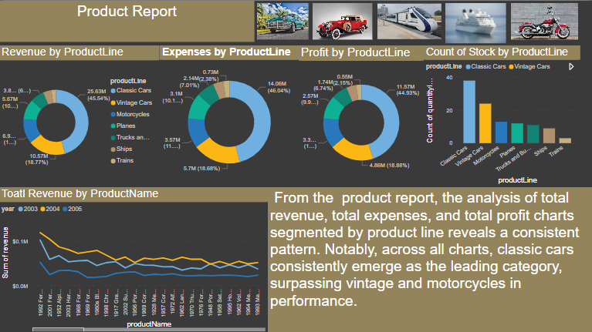
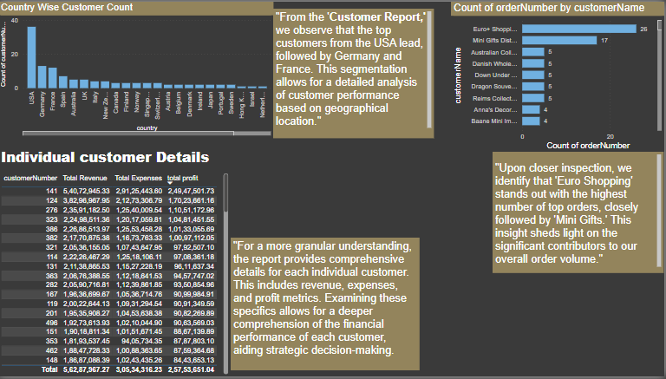
MY DESIGNS

Slide 6
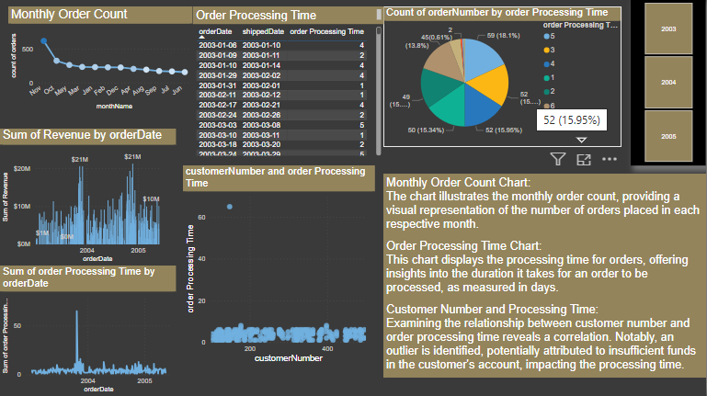
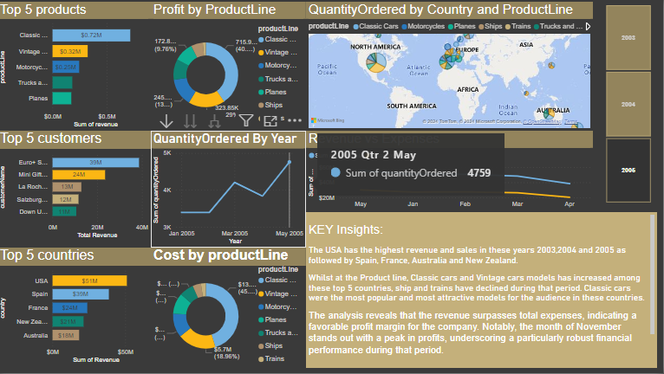
MY DESIGNS

Slide 7
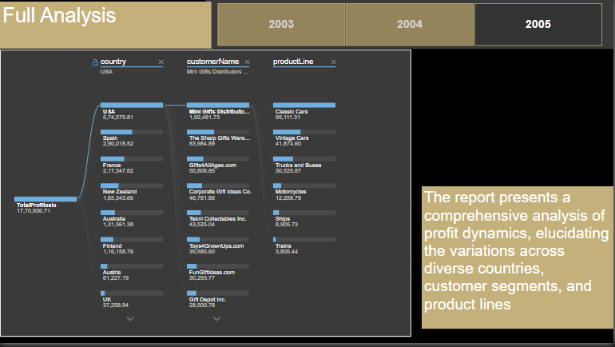
MY DESIGNS

Slide 8
CONCLUSION
The Customers of Classic model company branches are located in 27 countries.
The USA has the highest number of orders of total 112 , followed by France 37 and Spain 36
List of employees, city, state, country and address where they work for company branch
List of orders shipped from 2003-2005 total(303)
Most sales by product line by Classic cars in top in list
Least sales were made in 2005 with only $1,290,293.23 and 37 by count
Most sales were made in 2004 with only $4,213,328.25 and 136 by count
Total sales recorded from 2003-2005 were $8,853,839.23
Total profit made $7,028 M

